Slide 1
TOPIC B2:
PROGRAMMING
LESSON B2-8
STACKS & QUEUES

Slide 2
AGENDA
Warm-up Question
Stacks
Stack Operations
Uses of Stacks
Queues
Queue Operations
Uses of Queues
NOTE!
Have a way to take notes and a way to write code available for this lesson

Slide 3

THE WARM UP QUESTION
Make a list of your top five movies
Then ask the user for their favorite movie
If the movie is already in the list, print a message saying that
If it’s not, add it to the list and print out the list

Slide 4
THE WARM UP ANSWER
movieList = ["Garfield", "Garfield: A Tale of Two Kitties", "Garfield's Pet Force", "Garfield Gets Real", "Garfield's Fun Fest"] movie = input("Enter a new movie: ") isInList = False for i in range(0,5): if(movie == movieList[i]): isInList = True if(isInList): print("Movie is already in list") else: print("Movie added") movieList.append(movie) print(movieList)

Slide 5
STACKS
Imagine that your parent made good on their promise to force you to wash dishes after a meal at an expensive restaurant
As beautifully demonstrated, the top plate is the one that gets cleaned
You cannot effectively clean a plate that isn’t the top plate
If you add a new plate, it goes on top of the stack of other plates

Slide 6
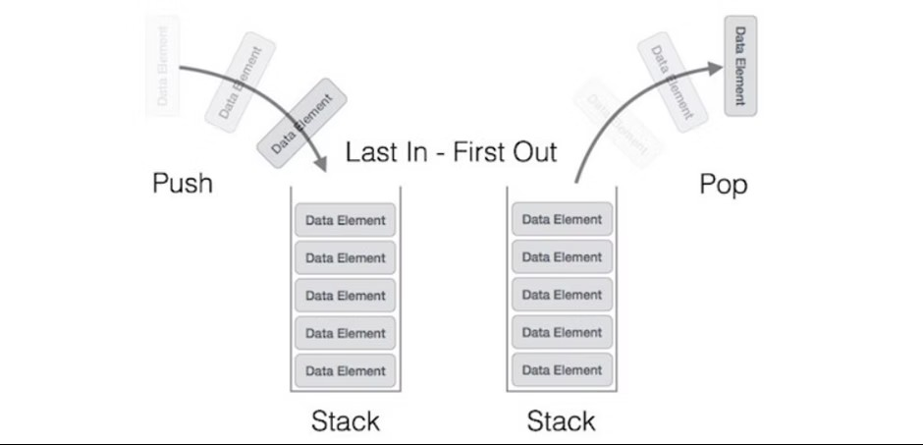
STACKS
And this logic underpins the data structure of the stack
The stack works on the “Last In, First Out” (LIFO) principle
The last thing added to the stack is the first thing that will be removed from the stack
Only the ‘top’ element of the stack is ever accessed

Slide 7
PUSH & POP
When you add an item to the top of a stack, this is referred to as a push operation
Removing the top item of a stack is referred to as a pop
Where have we seen this terminology so far?

Slide 8
IMPLEMENTATION
Python does not come in with a built-in stack data type (booo)
From here, we have two options
We can enforce stack-styled restrictions onto our list
What would these restrictions be?

Slide 9
IMPLEMENTATION
If we restrict ourselves to only operating on lists using .append( ) and .pop( ) functions (with nothing in the .pop) they will behave like stacks!
stack = [] stack.append(10) stack.append(20) stack.append(15) stack.pop() stack.append(25) stack.append(90) stack.pop() print(stack)

Slide 10
IMPLEMENTATION
If we want to strictly enforce stack constraints though, we can use the python queue library to import what’s called a LIFO Queue
Instead of push or append, they use .put( ), and instead of .pop( ), they use .get( )
You are free to use these, but I would recommend using the lists as we just discussed
from queue import LifoQueue # Initializing a stack stack = LifoQueue(maxsize=3) # qsize() show the number of elements print(stack.qsize()) #pushing elements stack.put('a') stack.put('b') stack.put('c') print("Full: ", stack.full()) print("Size: ", stack.qsize()) #popping elements print('\nElements popped from the stack') print(stack.get()) print(stack.get()) print(stack.get()) print("\nEmpty: ", stack.empty())

Slide 11
STACK OPERATIONS
Checking if the stack is empty:
Not a built in feature, check to see if len(stack) == 0
Peeking at the top element of the stack without popping it:
Access the top element of the stack by indexing it like so:
stack = [] stack.append("Joe") stack.append("Toe") stack.append("Moe") print(stack[len(stack)-1]) stack.pop() stack.pop() stack.pop() print(len(stack) == 0)

Slide 12
USES OF STACKS
What are some use cases that you can think of for stacks like this?

Slide 13
USES OF STACKS
Creating an undo feature in applications
Push the actions you take to a stack, pop them off if they are undone
Going back pages in a web browser
Interrupt handling in a CPU (will discuss in depth later)
Evaluating arithmetic expressions in Reverse Polish Notation
Recursion

Slide 14
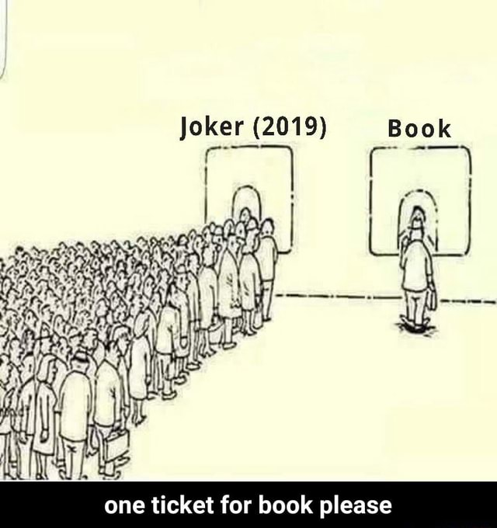
QUEUES
Now, imagine that you’re at the end of a long, long line at the ticket booth
You’ll have to wait for the people who got into line first to get through before you get the chance
Obviously, if you cut in line you don’t have a soul
The first person to enter the line is the first person to leave

Slide 15
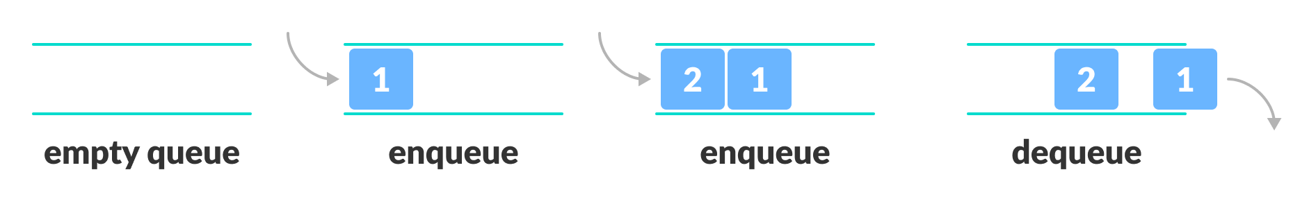
STACKS
And this logic underpins the data structure of the queue
The queue works on the “First In, First Out” (FIFO) principle
The first thing added to the queue is the first thing that will be removed from the queue
Only the ‘front’ element of the queue is ever accessed

Slide 16
ENQUEUE & DEQUEUE
To add an item to the end of the queue, we enqueue it
To remove an item from the front of the queue, we dequeue it

Slide 17
IMPLEMENTATION
Python does not come in with a built-in queue data type either (booo again)
From here, we have two options
We can enforce queue-styled restrictions onto our list
What would these restrictions be?

Slide 18
IMPLEMENTATION
If we restrict ourselves to only operating on lists using .append( ) and .pop(0) functions they will behave like stacks!
queue = [] queue.append("12") queue.append("13") queue.append("14") queue.pop(0) queue.pop(0) queue.append("15") print(queue)

Slide 19
IMPLEMENTATION
If we want to strictly enforce queue constraints though, we can use the python queue library to import a Queue
Instead of queue or append, they use .put( ), and instead of dequeue or .pop( ), they use .get( )
You are free to use these, but I would recommend using the lists as we just discussed
from queue import Queue #initializing a queue q = Queue(maxsize = 3) #shows the number of elements print(q.qsize()) #enqueueing elements q.put('a') q.put('b') q.put('c') print("\nFull: ", q.full()) print("\nElements dequeued from the queue") #dequeueing elements print(q.get()) print(q.get()) print(q.get()) print("\nEmpty: ", q.empty())

Slide 20
QUEUE OPERATIONS
Checking if the queue is empty:
Not a built in feature, check to see if len(queue) == 0
Examining the element in the front of the queue without dequeueing it:
Access the top element of the stack by indexing it like so:
queue = [] queue.append("Joe") queue.append("Toe") queue.append("Moe") print(queue[0]) queue.pop(0) queue.pop(0) queue.pop(0) print(len(queue)==0)

Slide 21
USES OF QUEUES
What are some use cases that you can think of for queues like this?

Slide 22
USES OF QUEUES
Printers store their tasks to print inside of queues, this way if multiple people send files at roughly the same time, then the one that sent it first will get printed first
Keyboards store keystrokes in queues, the first letter typed is the first letter that shows up on screen
Simulations of real world queues for data modelling will often use the queue data structure as well

Slide 23
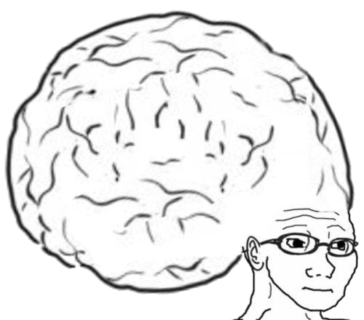
VOCAB TO REMEMBER
Stack
Queue
Pop
Push
Enqueue
Dequeue
FIFO
LIFO

Slide 24
PROGRAMMING ASSIGNMENT
Check the github repository for this class to find PA B2-4!
Good luck, and let me know if you need any help!

